Slide 1
Design Presentation: Data Transformations
Owner: Sean Norman
CSA07P | 1 of 2
Session Day/Time: | Day 1, Ingest & Transform: 13:00-13:30 | Presenters/SMEs: | Presenter: John Doe SME(s): John Doe; Jane Doe
Virtual Format and Software: | Presentation: Single Speaker Presenter, ppt slide presentation, live virtual broadcast via Teams, chat enabled and moderated
Cohort / Breakout Mgmt | No cohorts / breakout activities during this session
Objective of Session: | As a result of attending this, attendees will better be able to…
Existing Sources: | <link to any supporting content sources (if any)>
Learner Content: | <Link to draft ppt slide deck and any other materials that the attendees would be seeing or using as part of this session>
Presenter/ SME Guide Content: | <Link to any supporting materials that are just for the presenter and/or supporting SMEs>
Required Homework + name of session for HW review: | No homework or pre-required content needed for this session

Slide 2
Design Presentation: Data Transformations
Owner: Sean Norman
CSA07P | 2 of 2
Session Flow and Detailed Agenda |  | Presenter/SME: | Time
Prework | No attendee pre-work needed for this session | N/A | N/A
Session Introduction | Set context for when this process takes place | <presenter> | 3 mins
Body of the session / discussion, activities, Q&A... | Data preparation and transformation Best practices - ETL vs ELT Develop Hub: SQL, Notebooks, Data Flows Orchestrate Hub: Notebook, Jobs Orchestration Data movement Connectors | <presenter> | 25 mins
Session Closing / Homework | Go to break Review timing for break, remind audience to stay signed into the meeting, when session will resume, and what they will be doing next. (Data Loading & Data Lake Organization) | <presenter> | 2 mins

Slide 3
Topics Covered
Data preparation and transformation Best practices - ETL vs ELT Develop Hub: SQL, Notebooks, Data Flows Orchestrate Hub: Notebook, Jobs Orchestration Data movement Connectors

Slide 4
Data Transformations
CSA07P

Slide 5

Agenda
1 Preparing to transform
Understanding and exploring the data.
4 Transform with Spark
Using notebooks to query SQL Pools and transform with open source modules.
2 Apply transformations
Apply coded and code-free transformations.
5 Best practices
Best practices for data transformation.
3 Serverless transforms
Use Azure Synapse SQL Serverless to transform data with SQL scripts.

Slide 6
Typical Data Transformations
Create persistent staging area / data vault
Standardize data from different sources
Remove duplicate rows
Impute missing values
Calculate derived values
Prepare data for facts and dimensions

Slide 7
ETL vs ELT
ETL transforms the data outside the warehouse. If transformations depend on data in the warehouse, the time to move data to the ETL process can be slow. Transformations are written in the language of the ETL tool.
ELT transforms data within the warehouse. This requires all data to be loaded to the DW before transformation. All transformations are written in SQL.
ELT is almost always faster than ETL.

Slide 8
Preparing to transform – exploratory data analysis

Slide 9
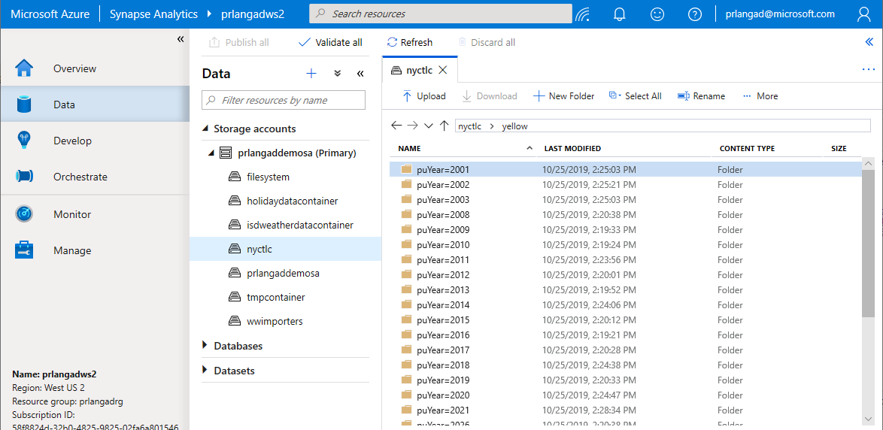
Navigating storage accounts
Browse Azure Data Lake Storage Gen2 accounts and filesystems – navigate through folders to see data
Filepath
ADLS Gen2 Account
Container (filesystem)

Slide 10
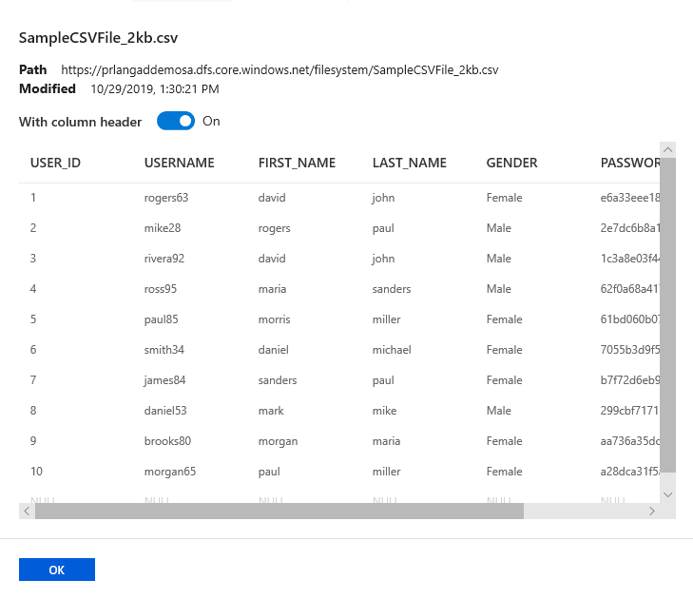
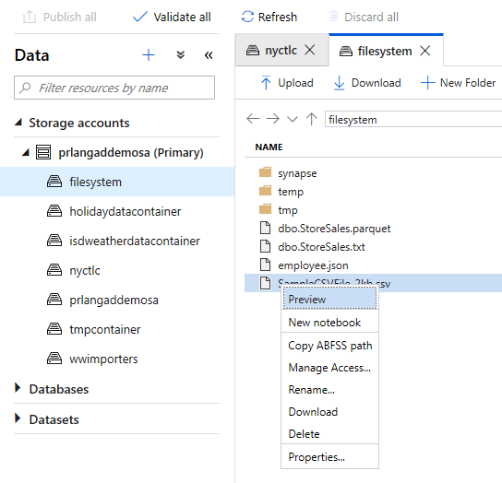
Preview CSV files in storage accounts
Preview a sample of your data

Slide 11
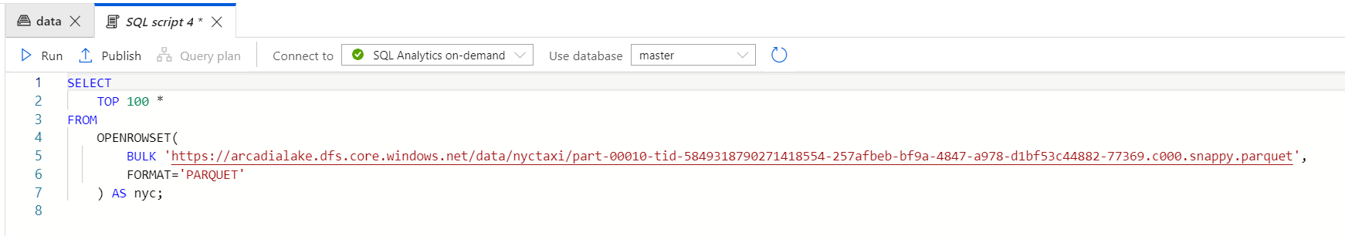
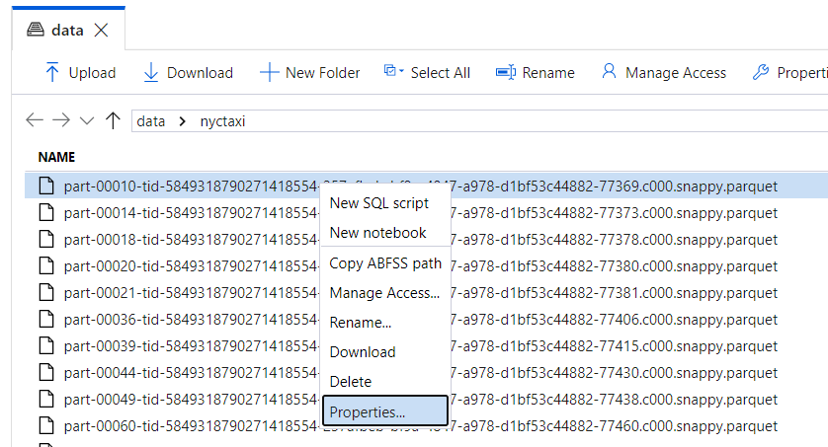
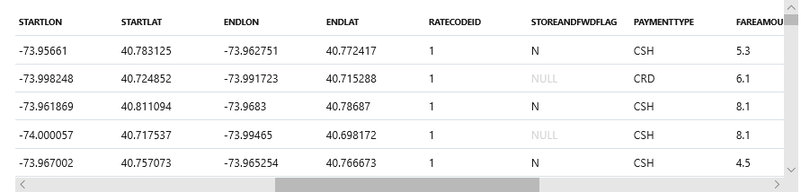
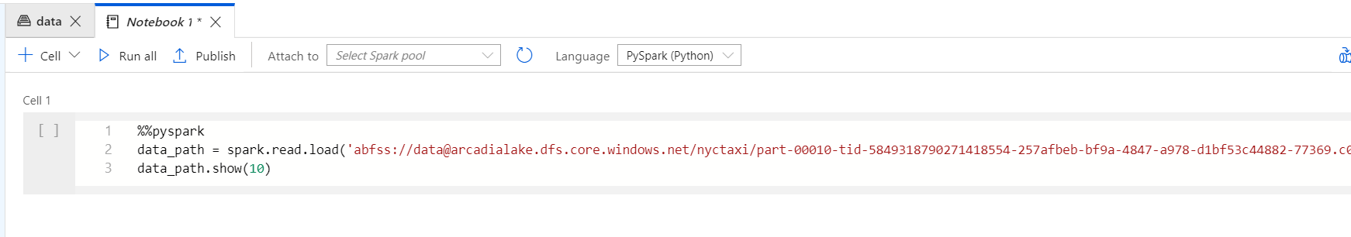
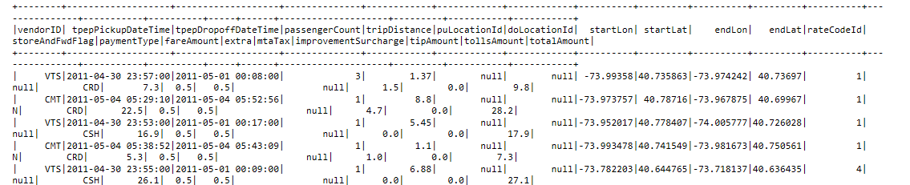
Query Parquet files in storage accounts
Two simple gestures to start analyzing with SQL scripts or with notebooks.
T-SQL or PySpark auto-generated.

Slide 12
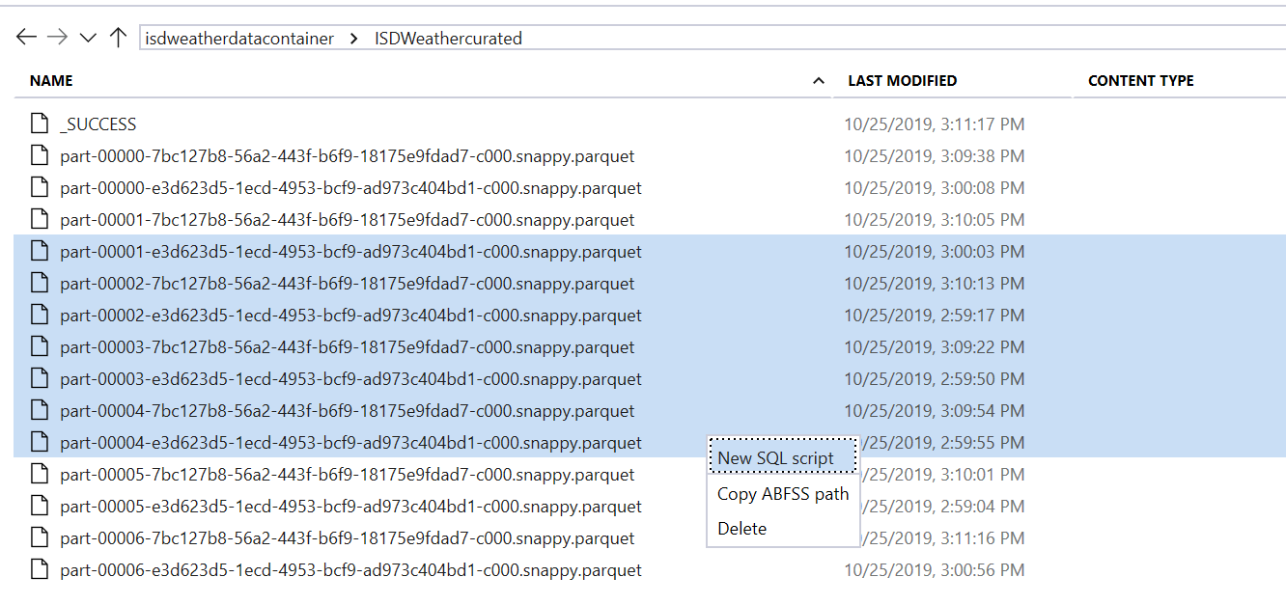
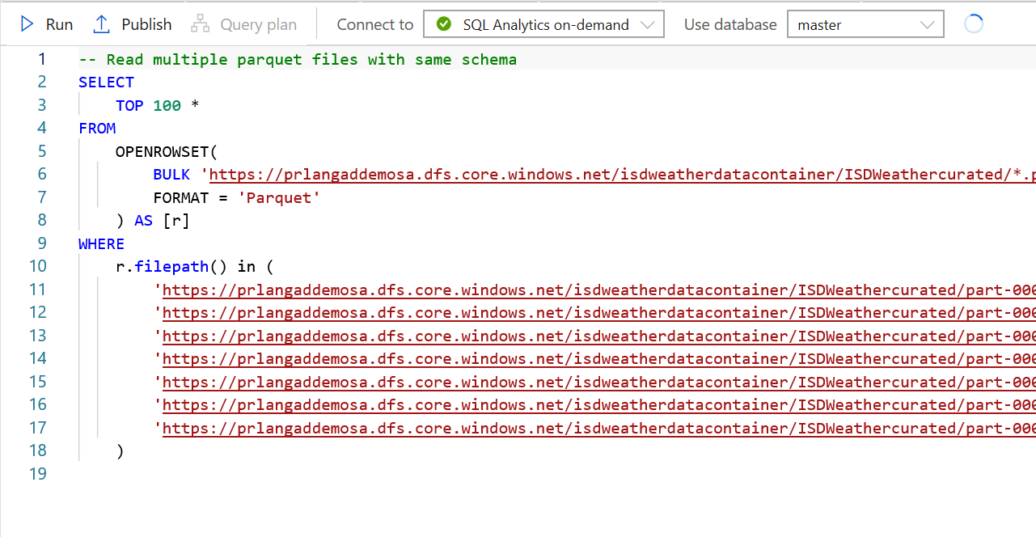
Multiple file selections supported
SQL Script from Multiple files
Multi-select of files generates a SQL script that analyzes all those files together

Slide 13
Applying transformations

Slide 14
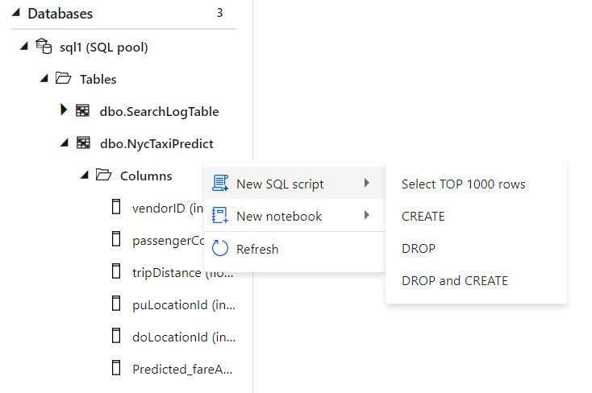
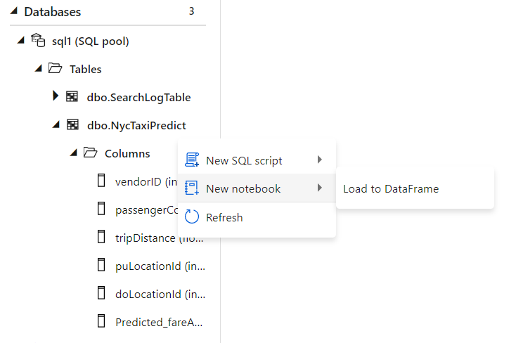
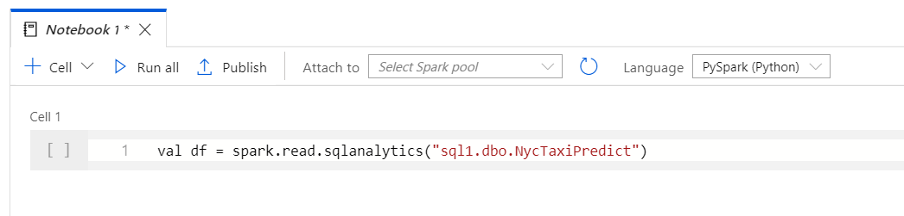
Code based transformations
Familiar gesture to generate T-SQL scripts from SQL metadata objects such as tables.
Starting from a table, auto-generate a single line of PySpark code that makes it easy to load a SQL table into a Spark dataframe​

Slide 15
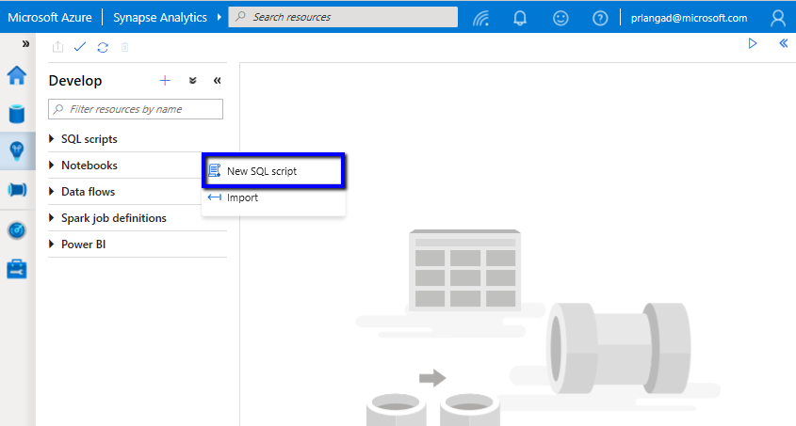
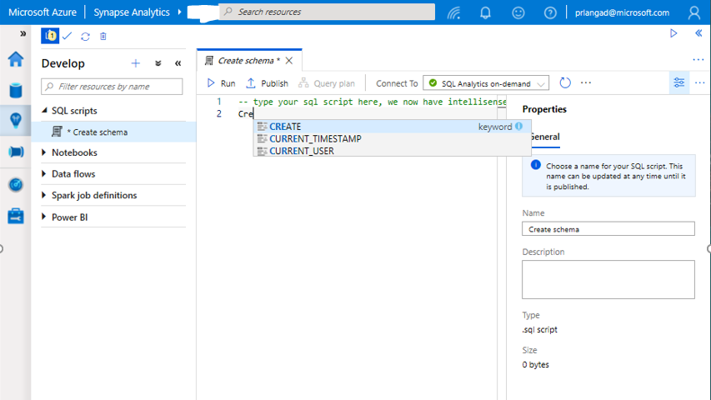
Transform with SQL script
SQL Script
Authoring SQL Scripts
Execute SQL script on provisioned SQL Pool or SQL On-demand
Publish individual SQL script or multiple SQL scripts through Publish all feature
Language support and intellisense

Slide 16
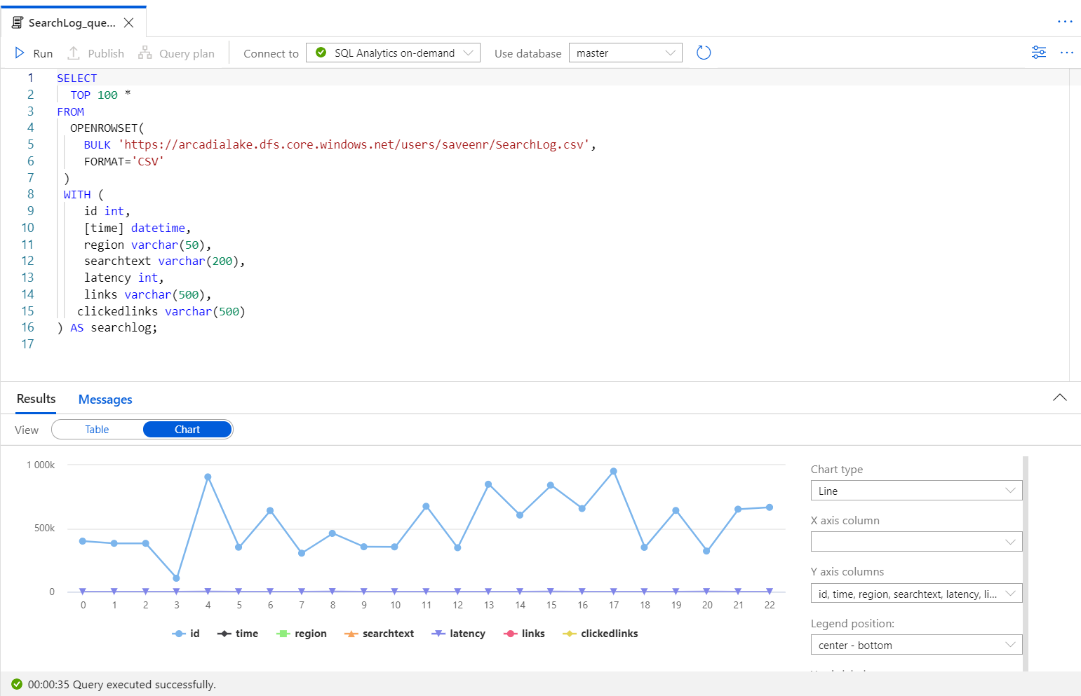
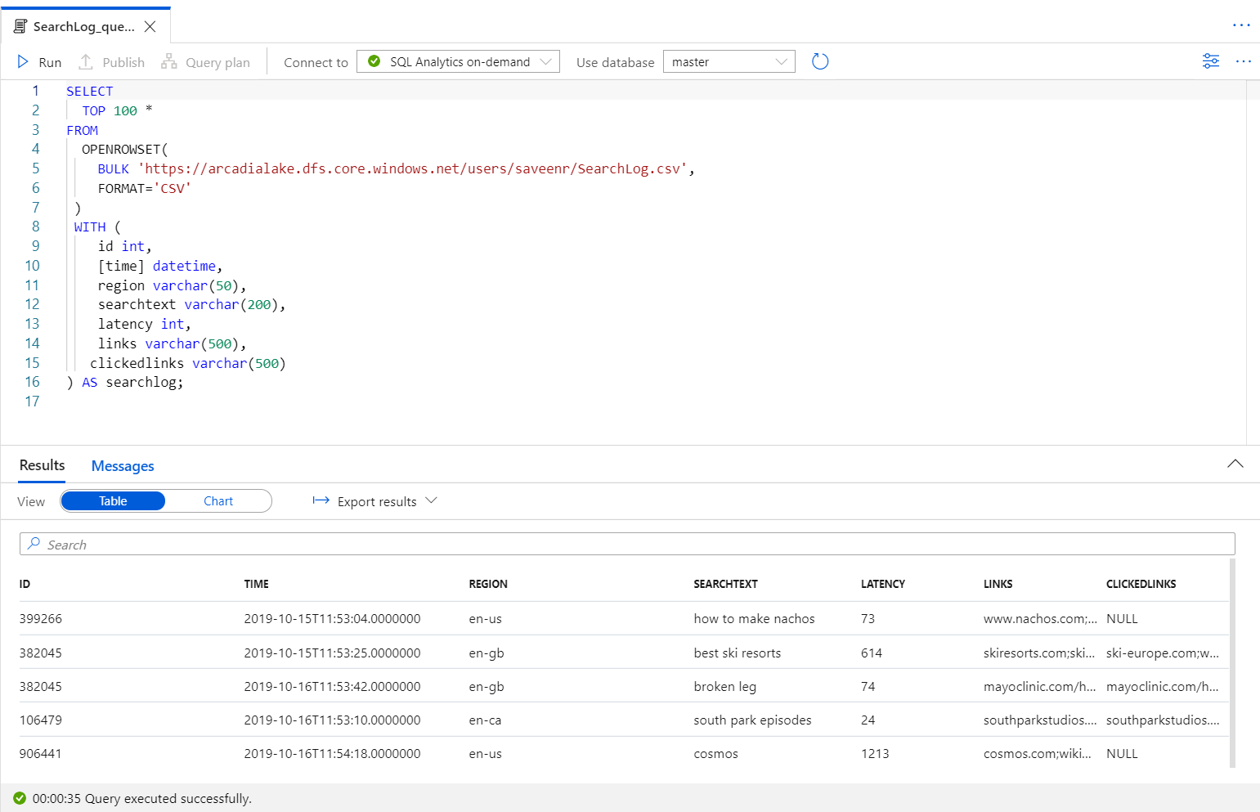
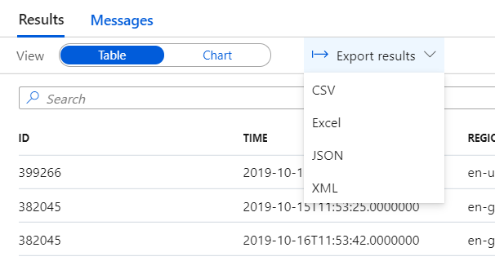

Transform with SQL script (2)
SQL Script
View results in Table or Chart form and export results in several popular formats

Slide 17
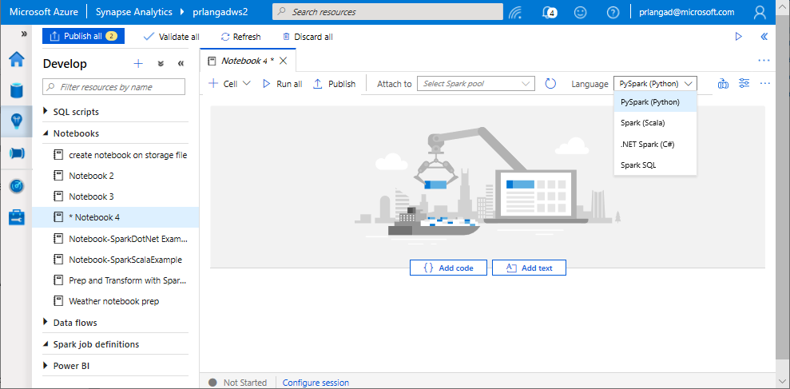
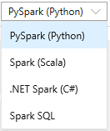
Transform with Notebooks
Notebooks
Allows to write multiple languages in one notebook
%%<Name of language>
Offers use of temporary tables across languages
Language support for Syntax highlight, syntax error, syntax code completion, smart indent, code folding
Export results

Slide 18
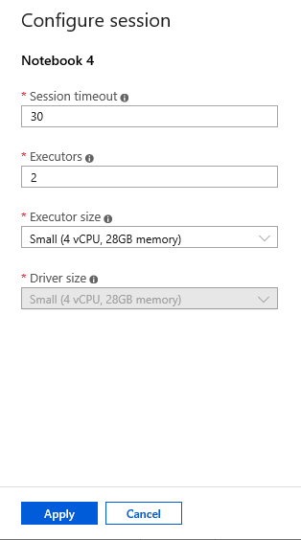
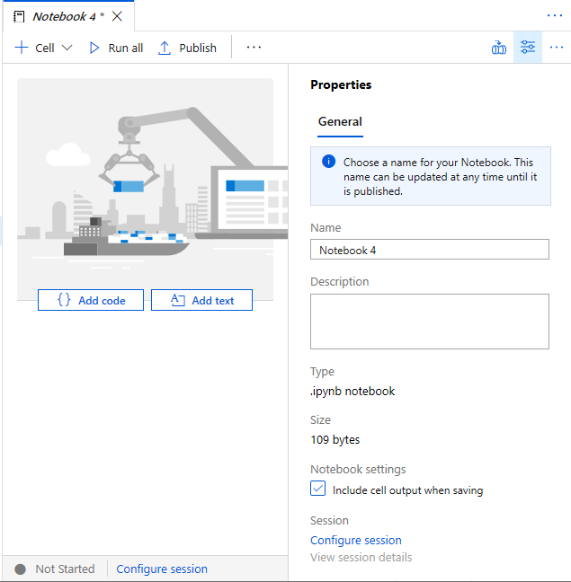
Transform with Notebooks (2)
Configure session allows developers to control how many resources are devoted to running their notebook.
Notes:
Spark pool-> spark session->
Add amount of compute

Slide 19
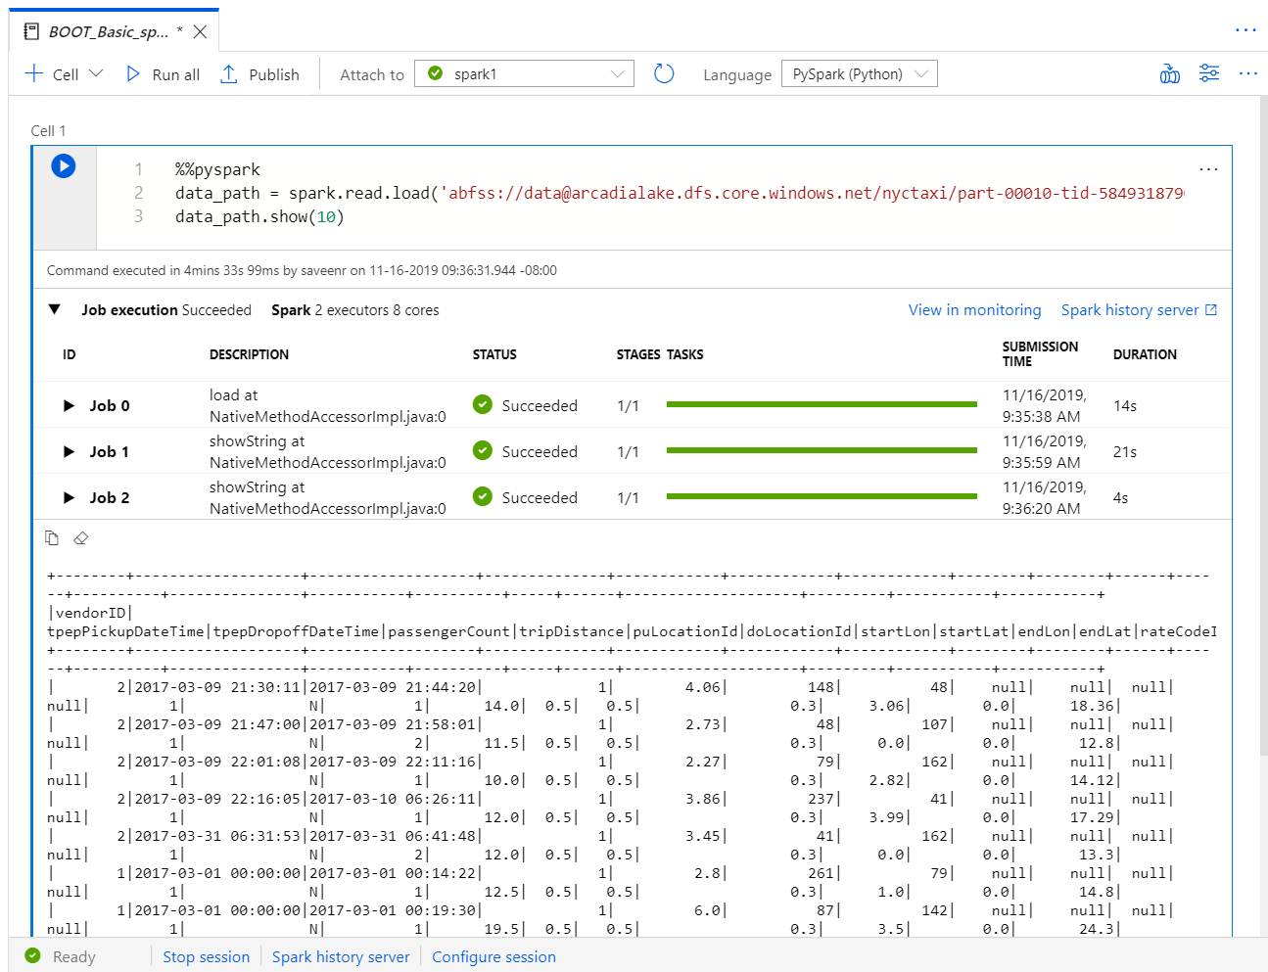
Transform with Notebooks (3)
As notebook cells run, the underlying Spark application status is shown. Providing immediate feedback and progress tracking.​

Slide 20
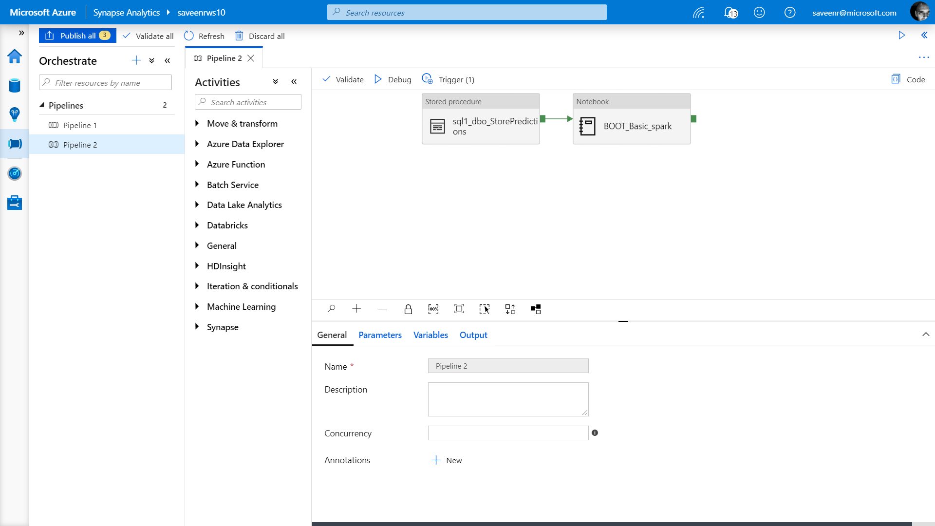
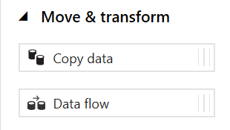
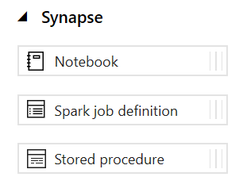
Transform with Pipelines
It provides ability to create pipelines to ingest, transform and load data with 90+ inbuilt connectors.
Offers a wide range of activities that a pipeline can perform.

Slide 21
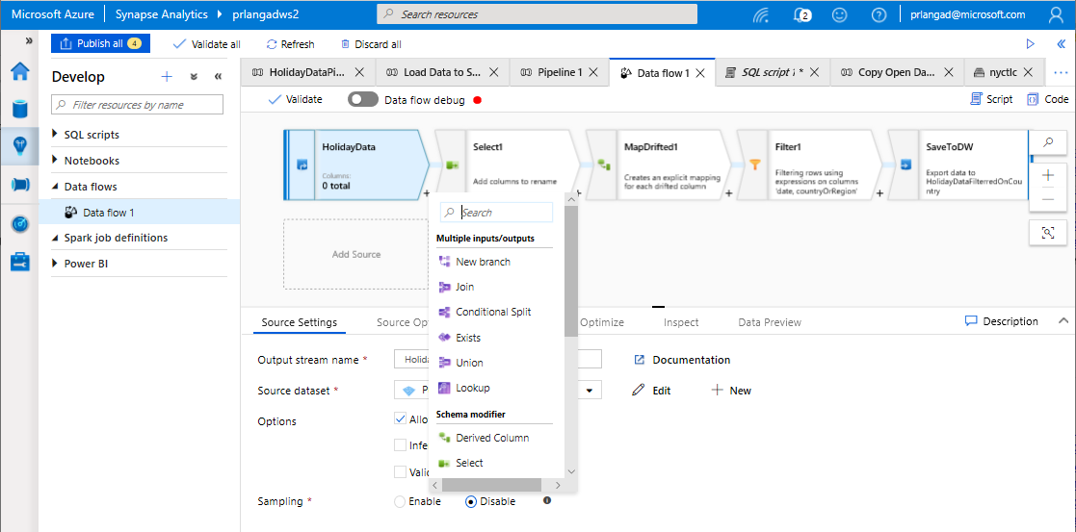
Transform with Data Flows
Data flows are a visual way of specifying how to transform data.
Provides a code-free experience.

Slide 22
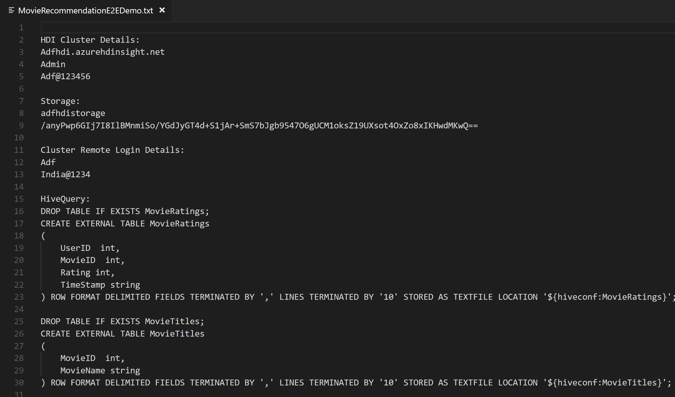
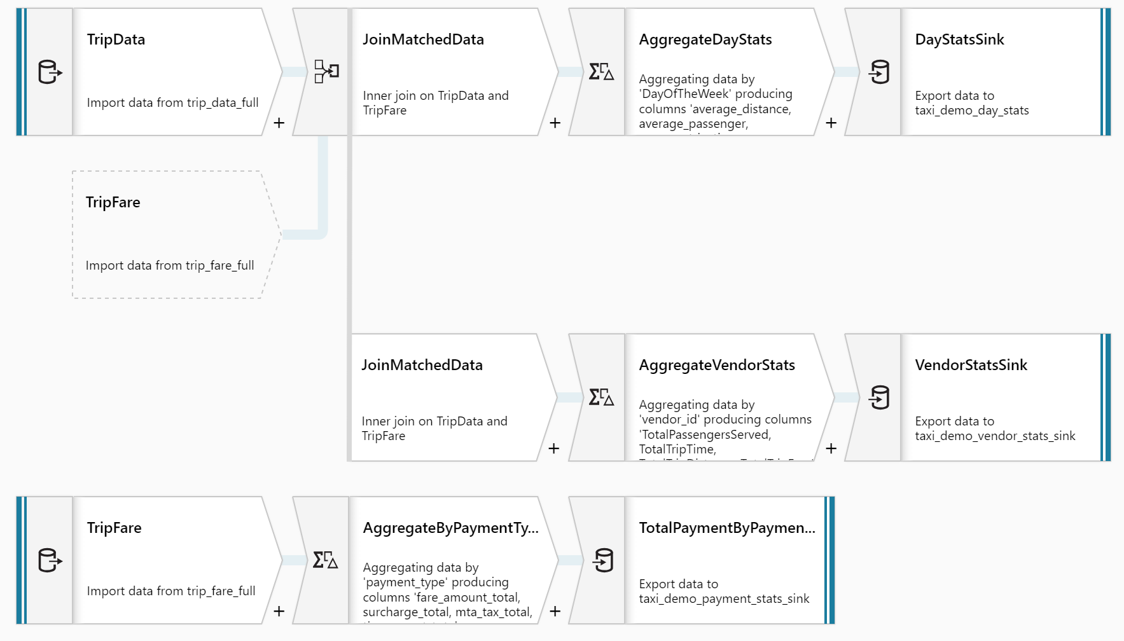
Transform with Data Flows (2)
Overview
It offers data cleansing, transformation, aggregation, conversion, etc
Benefits
Cloud scale via Spark execution
Guided experience to easily build resilient data flows
Flexibility to transform data per user’s comfort
Monitor and manage dataflows from a single pane of glass
… not

Slide 23
Transform with Serverless

Slide 24





Transform with Synapse SQL Serverless
Overview
An interactive query service that provides T-SQL queries over high scale data in Azure Storage.
Benefits
Serverless
No infrastructure
Pay only for query execution
No ETL
Offers security
Data integration with Databricks, HDInsight
T-SQL syntax to query data
Supports data in various formats (Parquet, CSV, JSON)
Support for BI ecosystem
Curate and transform data
Power BI
SQL On Demand Query
Azure Data Studio
Sync table definitions
Read and write
data files
SSMS
Read and write
data files
10
01
Azure Storage

Slide 25
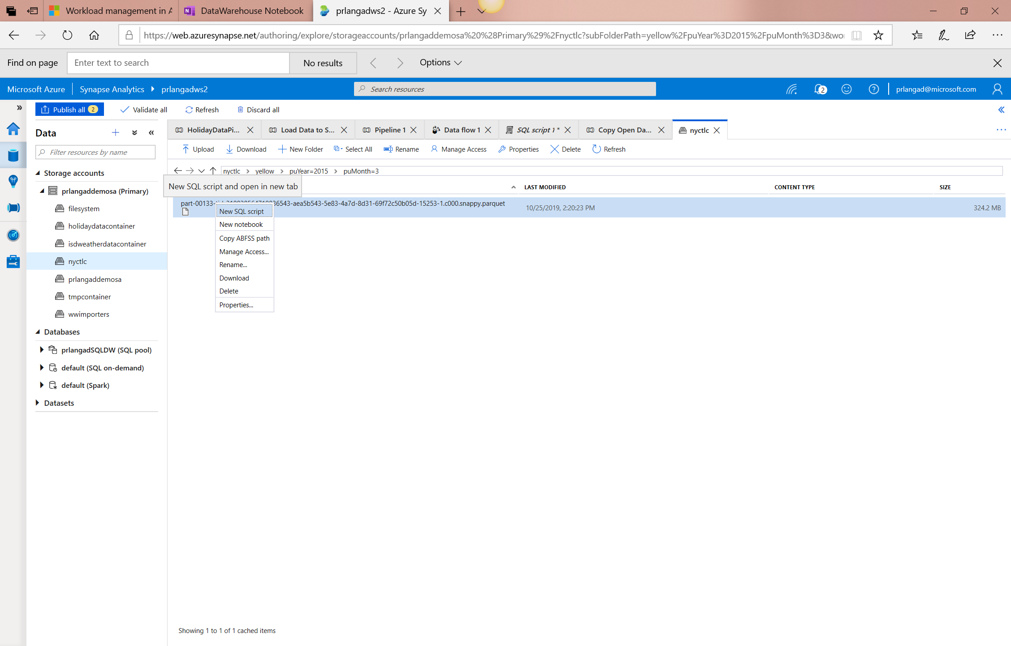
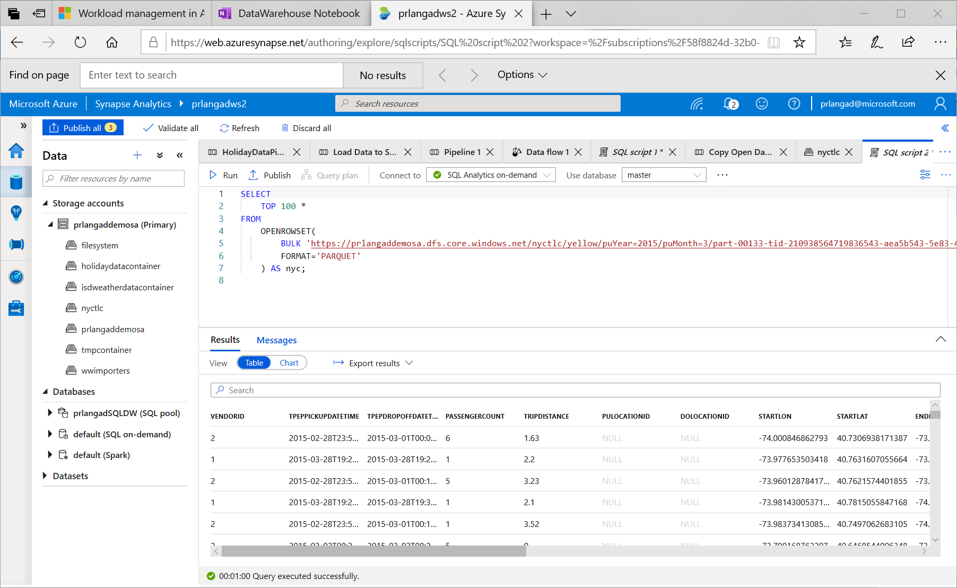
Synapse SQL Serverless – Querying on storage

Slide 26
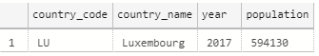
Synapse SQL Serverless – Querying CSV File
Overview
Uses OPENROWSET function to access data
Benefits
Ability to read CSV File with
- no header row, Windows style new line
- no header row, Unix-style new line
- header row, Unix-style new line
- header row, Unix-style new line, quoted
- header row, Unix-style new line, escape
- header row, Unix-style new line, tab-delimited
- without specifying all columns
SELECT *
FROM OPENROWSET(
BULK 'https://XXX.blob.core.windows.net/csv/population/population.csv',
FORMAT = 'CSV',
FIELDTERMINATOR =',',
ROWTERMINATOR = '\n'
)
WITH (
[country_code] VARCHAR (5) COLLATE Latin1_General_BIN2,
[country_name] VARCHAR (100) COLLATE Latin1_General_BIN2,
[year] smallint,
[population] bigint
) AS [r]
WHERE
country_name = 'Luxembourg'
AND year = 2017

Slide 27
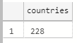
Synapse SQL Serverless – Querying CSV File
Read CSV file - header row, Unix-style new line
Read CSV file - without specifying all columns
SELECT *
FROM OPENROWSET(
BULK 'https://XXX.blob.core.windows.net/csv/population-unix-hdr/population.csv',
FORMAT = 'CSV',
FIELDTERMINATOR =',',
ROWTERMINATOR = '0x0a',
FIRSTROW = 2
)
WITH (
[country_code] VARCHAR (5) COLLATE Latin1_General_BIN2,
[country_name] VARCHAR (100) COLLATE Latin1_General_BIN2,
[year] smallint,
[population] bigint
) AS [r]
WHERE
country_name = 'Luxembourg'
AND year = 2017
SELECT
COUNT(DISTINCT country_name) AS countries
FROM OPENROWSET(
BULK 'https://XXX.blob.core.windows.net/csv/population/population.csv',
FORMAT = 'CSV',
FIELDTERMINATOR =',',
ROWTERMINATOR = '\n'
)
WITH (
[country_name] VARCHAR (100) COLLATE Latin1_General_BIN2 2
) AS [r]

Slide 28
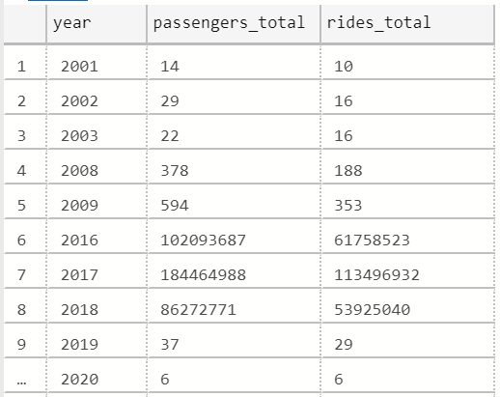
Synapse SQL Serverless – Querying folders
Overview
Uses OPENROWSET function to access data from
multiple files or folders
Benefits
Offers reading multiple files/folders through usage of wildcards
Offers reading specific file/folder
Supports use of multiple wildcards
SELECT YEAR(pickup_datetime) as [year], SUM(passenger_count) AS passengers_total, COUNT(*) AS [rides_total]
FROM OPENROWSET(
BULK 'https://XXX.blob.core.windows.net/csv/taxi/*.*’,
FORMAT = 'CSV’
, FIRSTROW = 2 )
WITH (
vendor_id VARCHAR(100) COLLATE Latin1_General_BIN2,
pickup_datetime DATETIME2,
dropoff_datetime DATETIME2,
passenger_count INT,
trip_distance FLOAT,
rate_code INT,
store_and_fwd_flag VARCHAR(100) COLLATE Latin1_General_BIN2,
pickup_location_id INT,
dropoff_location_id INT,
payment_type INT,
fare_amount FLOAT,
extra FLOAT, mta_tax FLOAT,
tip_amount FLOAT,
tolls_amount FLOAT,
improvement_surcharge FLOAT,
total_amount FLOAT
) AS nyc
GROUP BY YEAR(pickup_datetime)
ORDER BY YEAR(pickup_datetime)

Slide 29
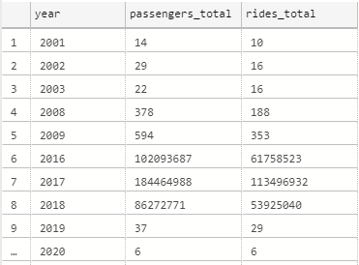
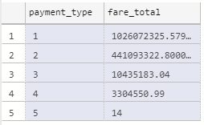
Synapse SQL Serverless – Querying folders
Read all files from multiple folders
Read subset of files in folder
SELECT YEAR(pickup_datetime) as [year],
SUM(passenger_count) AS passengers_total,
COUNT(*) AS [rides_total]
FROM OPENROWSET(
BULK 'https://XXX.blob.core.windows.net/csv/t*i/',
FORMAT = 'CSV',
FIRSTROW = 2 )
WITH (
vendor_id VARCHAR(100) COLLATE Latin1_General_BIN2,
pickup_datetime DATETIME2,
dropoff_datetime DATETIME2,
passenger_count INT,
trip_distance FLOAT,
<… columns>
) AS nyc
GROUP BY YEAR(pickup_datetime)
ORDER BY YEAR(pickup_datetime)
SELECT
payment_type,
SUM(fare_amount) AS fare_total
FROM OPENROWSET(
BULK 'https://XXX.blob.core.windows.net/csv/taxi/yellow_tripdata_2017-*.csv',
FORMAT = 'CSV',
FIRSTROW = 2 )
WITH (
vendor_id VARCHAR(100) COLLATE Latin1_General_BIN2,
pickup_datetime DATETIME2,
dropoff_datetime DATETIME2,
passenger_count INT,
trip_distance FLOAT,
<…columns>
) AS nyc
GROUP BY payment_type
ORDER BY payment_type

Slide 30
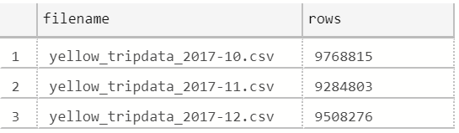
Synapse SQL Serverless – Querying specific files
Overview
filename – Provides file name that originates row result
filepath – Provides full path when no parameter is passed or part of path when parameter is passed that originates result
Benefits
Provides source name/path of file/folder for row result set
Example of filename function
SELECT
r.filename() AS [filename]
,COUNT_BIG(*) AS [rows]
FROM OPENROWSET(
BULK 'https://XXX.blob.core.windows.net/csv/taxi/yellow_tripdata_2017-1*.csv’,
FORMAT = 'CSV',
FIRSTROW = 2
)
WITH (
vendor_id INT,
pickup_datetime DATETIME2,
dropoff_datetime DATETIME2,
passenger_count SMALLINT,
trip_distance FLOAT,
<…columns>
) AS [r]
GROUP BY r.filename()
ORDER BY [filename]

Slide 31
Synapse SQL Serverless – Querying specific files
Example of filepath function
SELECT
r.filepath() AS filepath
,r.filepath(1) AS [year]
,r.filepath(2) AS [month]
,COUNT_BIG(*) AS [rows]
FROM OPENROWSET(
BULK 'https://XXX.blob.core.windows.net/csv/taxi/yellow_tripdata_*-*.csv’,
FORMAT = 'CSV',
FIRSTROW = 2 )
WITH (
vendor_id INT,
pickup_datetime DATETIME2,
dropoff_datetime DATETIME2,
passenger_count SMALLINT,
trip_distance FLOAT,
<… columns>
) AS [r]
WHERE r.filepath(1) IN ('2017’)
AND r.filepath(2) IN ('10', '11', '12’)
GROUP BY r.filepath() ,r.filepath(1) ,r.filepath(2)
ORDER BY filepath
filepath | year | month | rows
https://XXX.blob.core.windows.net/csv/taxi/yellow_tripdata_2017-10.csv | 2017 | 10 | 9768815
https://XXX.blob.core.windows.net/csv/taxi/yellow_tripdata_2017-11.csv | 2017 | 11 | 9284803
https://XXX.blob.core.windows.net/csv/taxi/yellow_tripdata_2017-12.csv | 2017 | 12 | 9508276

Slide 32
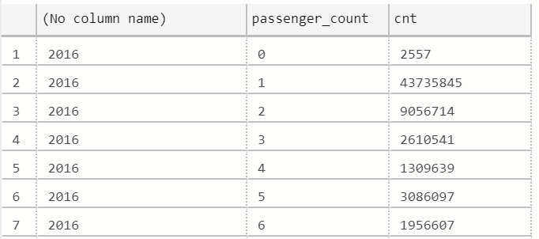
Synapse SQL Serverless – Querying Parquet files
Overview
Uses OPENROWSET function to access data
Benefits
Ability to specify column names of interest
Offers auto reading of column names and data types
Provides target specific partitions using filepath function
SELECT
YEAR(pickup_datetime),
passenger_count,
COUNT(*) AS cnt
FROM
OPENROWSET(
BULK 'https://XXX.blob.core.windows.net/parquet/taxi/*/*/*',
FORMAT='PARQUET'
) WITH (
pickup_datetime DATETIME2,
passenger_count INT
) AS nyc
GROUP BY
passenger_count,
YEAR(pickup_datetime)
ORDER BY
YEAR(pickup_datetime),
passenger_count

Slide 33
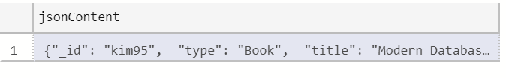
Synapse SQL Serverless – Querying JSON files
Overview
Read JSON files and provides data in tabular format
Benefits
Supports OPENJSON, JSON_VALUE and JSON_QUERY functions
SELECT *
FROM
OPENROWSET(
BULK 'https://XXX.blob.core.windows.net/json/books/book1.json’,
FORMAT='CSV',
FIELDTERMINATOR ='0x0b',
FIELDQUOTE = '0x0b',
ROWTERMINATOR = '0x0b'
)
WITH (
jsonContent varchar(8000)
) AS [r]

Slide 34
Synapse SQL Serverless – Querying JSON files
Example of JSON_VALUE function
Example of JSON_QUERY function
SELECT
JSON_VALUE(jsonContent, '$.title') AS title,
JSON_VALUE(jsonContent, '$.publisher') as publisher,
jsonContent
FROM
OPENROWSET(
BULK 'https://XXX.blob.core.windows.net/json/books/*.json',
FORMAT='CSV',
FIELDTERMINATOR ='0x0b',
FIELDQUOTE = '0x0b',
ROWTERMINATOR = '0x0b'
)
WITH (
jsonContent varchar(8000)
) AS [r]
WHERE
JSON_VALUE(jsonContent, '$.title') = 'Probabilistic and Statistical Methods in Cryptology, An Introduction by Selected Topics'
SELECT
JSON_QUERY(jsonContent, '$.authors') AS authors,
jsonContent
FROM
OPENROWSET(
BULK 'https://XXX.blob.core.windows.net/json/books/*.json',
FORMAT='CSV',
FIELDTERMINATOR ='0x0b',
FIELDQUOTE = '0x0b',
ROWTERMINATOR = '0x0b'
)
WITH (
jsonContent varchar(8000)
) AS [r]
WHERE
JSON_VALUE(jsonContent, '$.title') = 'Probabilistic and Statistical Methods in Cryptology, An Introduction by Selected Topics'

Slide 35
Transform with Spark

Slide 36
Transforming with Spark – Querying SQL Pools
Existing Approach
New Approach Using Scala
val jdbcUsername = "<SQL DB ADMIN USER>"
val jdbcPwd = "<SQL DB ADMIN PWD>"
val jdbcHostname = "servername.database.windows.net”
val jdbcPort = 1433
val jdbcDatabase ="<AZURE SQL DB NAME>“
val jdbc_url = s"jdbc:sqlserver://${jdbcHostname}:${jdbcPort};database=${jdbcDatabase};encrypt=true;trustServerCertificate=false;hostNameInCertificate=*.database.windows.net;loginTimeout=60;“
val connectionProperties = new Properties()
connectionProperties.put("user", s"${jdbcUsername}")
connectionProperties.put("password", s"${jdbcPwd}")
val sqlTableDf = spark.read.jdbc(jdbc_url, “dbo.Tbl1", connectionProperties)
// Construct a Spark DataFrame from SQL Pool table
var df = spark.read.sqlanalytics("sql1.dbo.Tbl1")
// Write the Spark DataFrame into SQL Pool table
df.write.sqlanalytics(“sql1.dbo.Tbl2”)
Using Python
%%spark
val df = spark.read.sqlanalytics("sql1.dbo.Tbl1")
df.createOrReplaceTempView("tbl1")
%%pyspark
sample = spark.sql("SELECT * FROM tbl1")
sample.createOrReplaceTempView("tblnew")
%%spark
val df = spark.sql("SELECT * FROM tblnew")
df.write.sqlanalytics(“sql1.dbo.tbl2", Constants.INTERNAL)
Notes:
Important Points:
No need to pre-create the table in the SQL Pool to write to, it will be created if it does not exist.
sqlanalytics only works in Scala language cells.
To read with other languages like Python, use Spark to register a temporary view and then query the view using Spark.SQL(“select * from viewname”)
To write with other languages, create a view for table you want write, then query from that view in Scala. Then write.

Slide 37
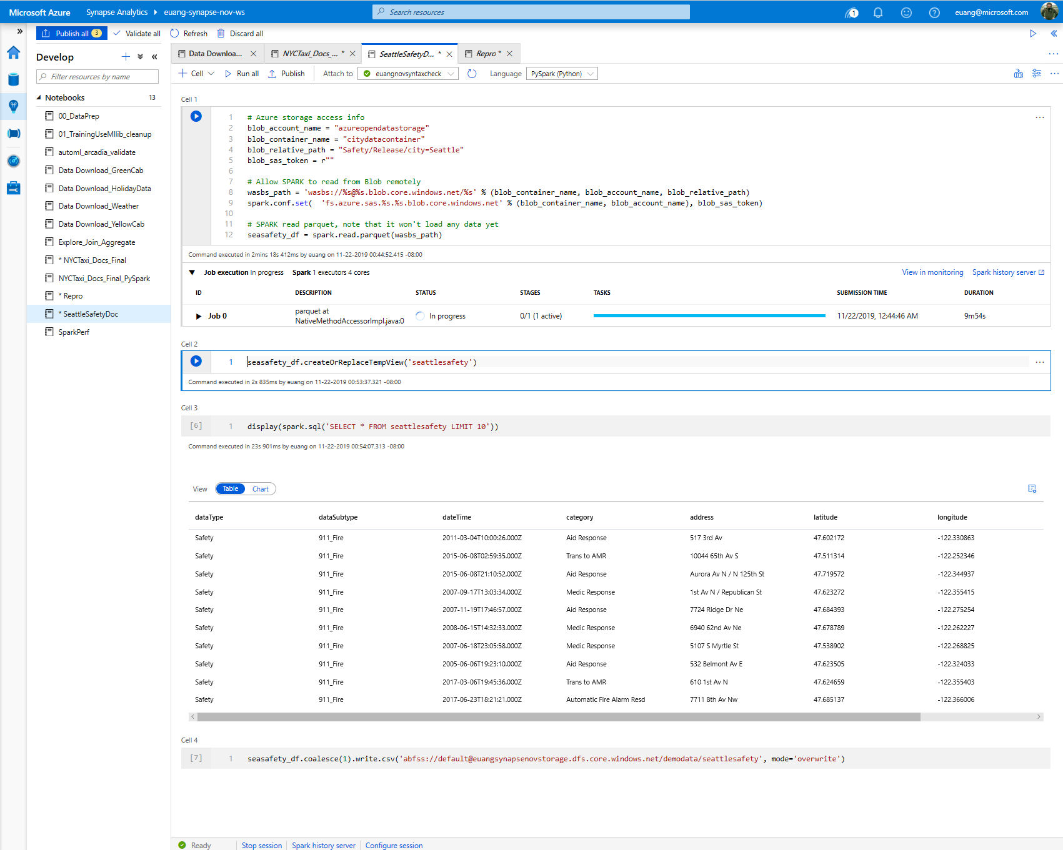
View results in table format

Slide 38
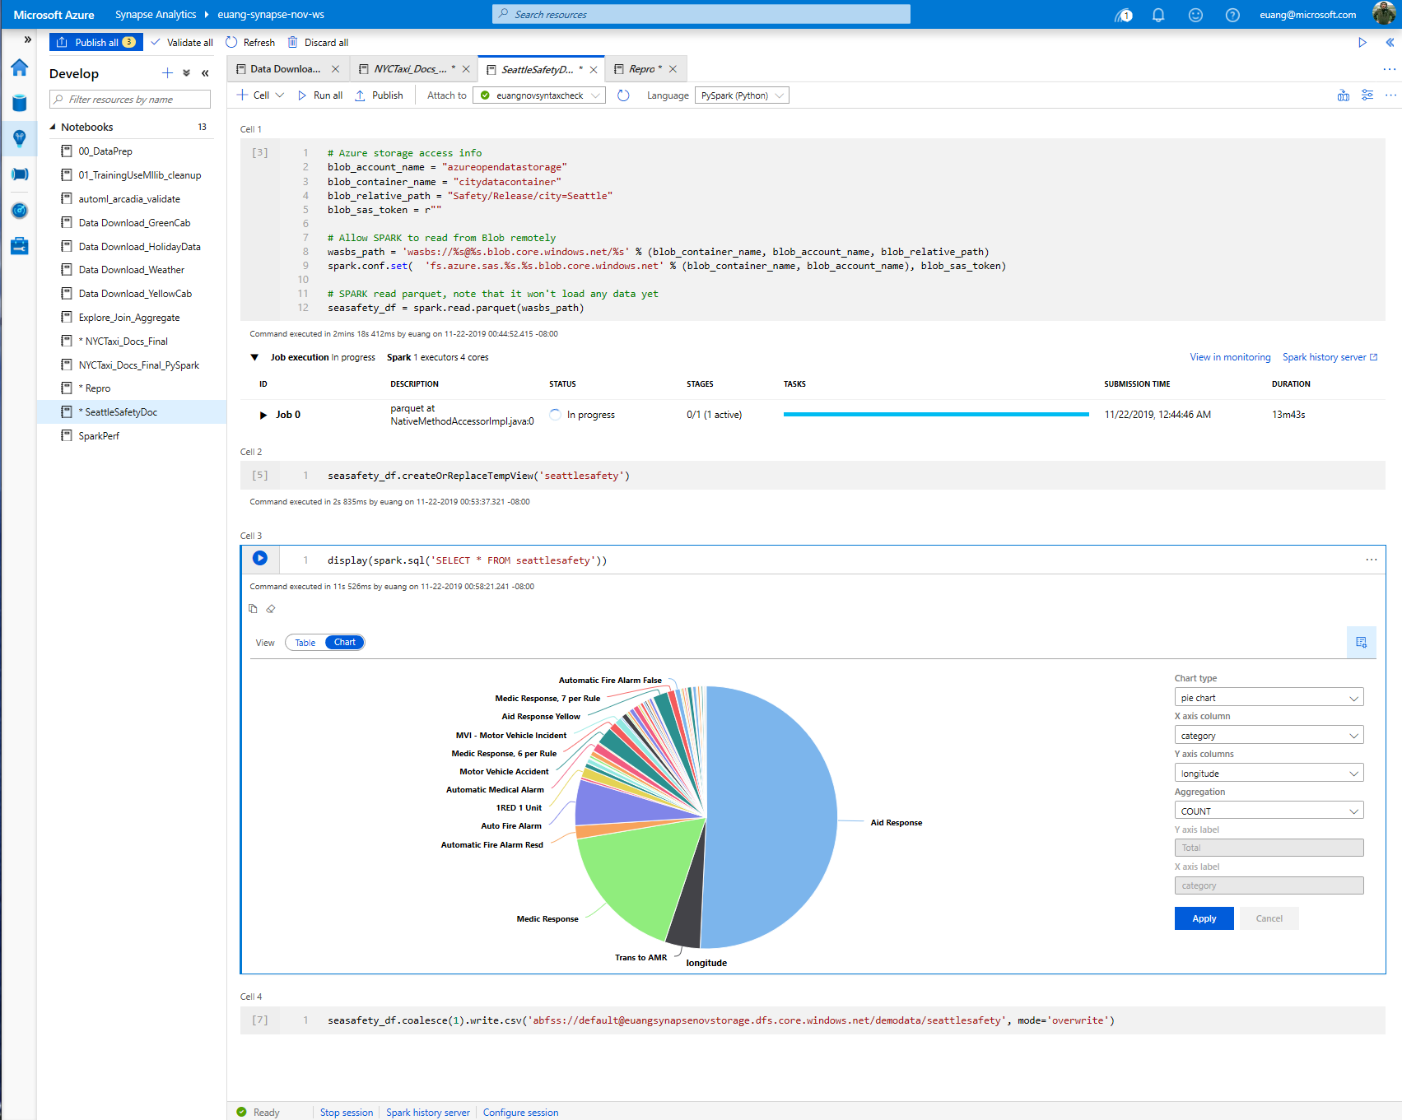
SQL support
View results in chart format

Slide 39
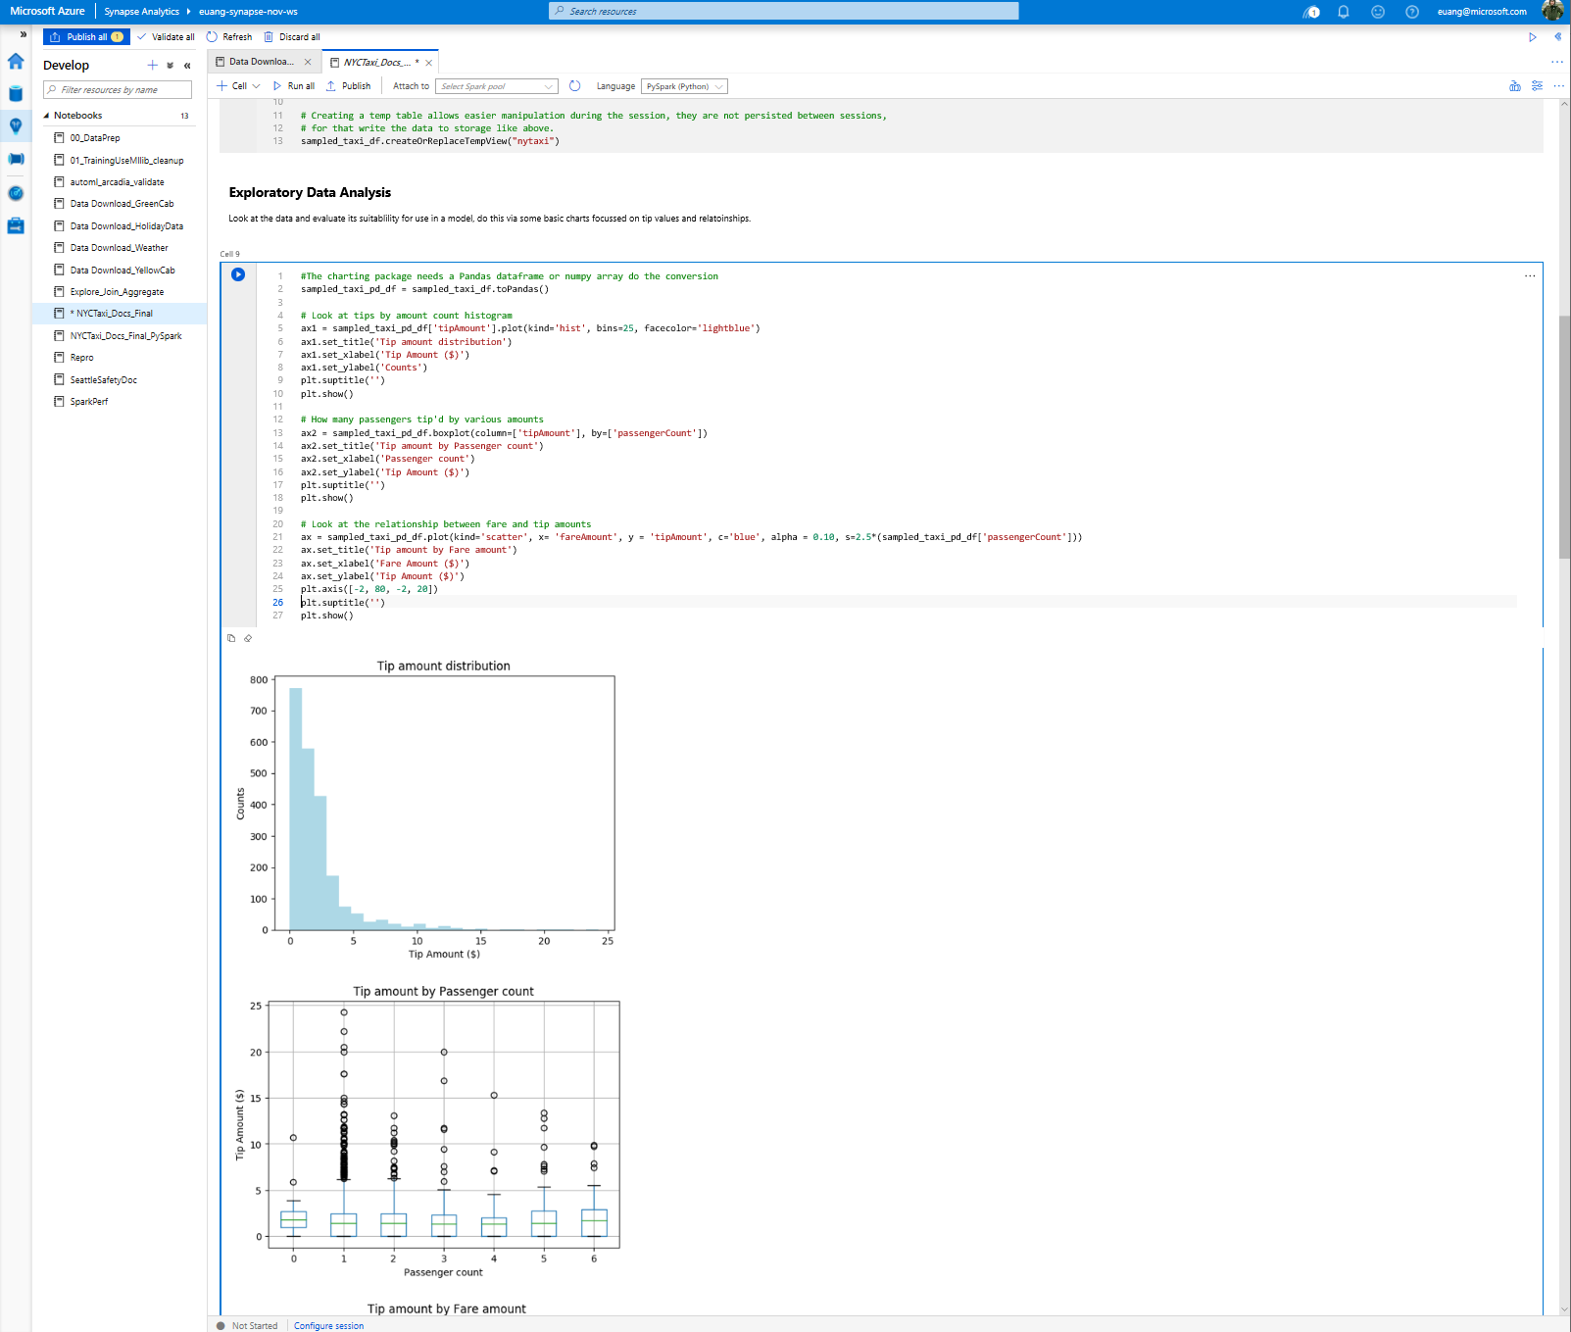
Exploratory data analysis with graphs – histogram, boxplot etc

Slide 40
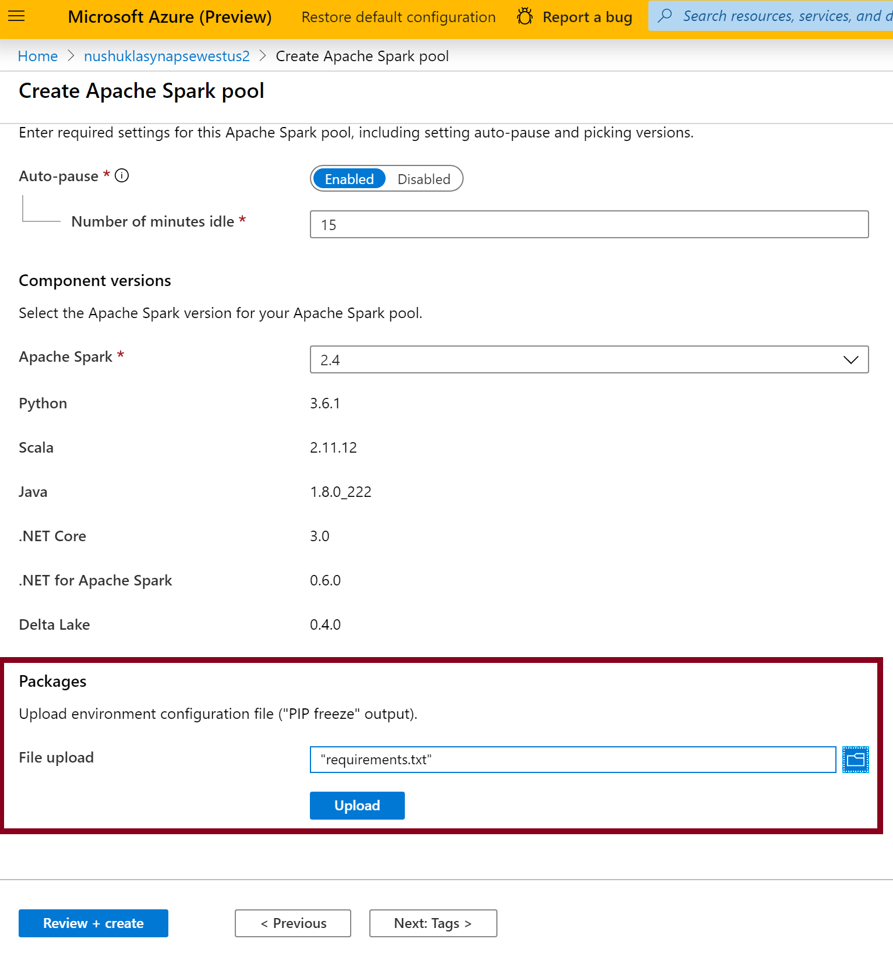
Library Management - Python
In the Portal Specify the new requirements while creating Spark Pool in Additional Settings blade
Overview
Add new python libraries at Spark pool level
Benefits
Input requirements.txt in simple pip freeze format
Add new libraries to your cluster
Update versions of existing libraries on your cluster
Libraries will get installed for your Spark pool during cluster creation
Ability to specify different requirements file for different pools within the same workspace
Constraints
The library version must exist on PyPI repository
Version downgrade of an existing library not allowed

Slide 41
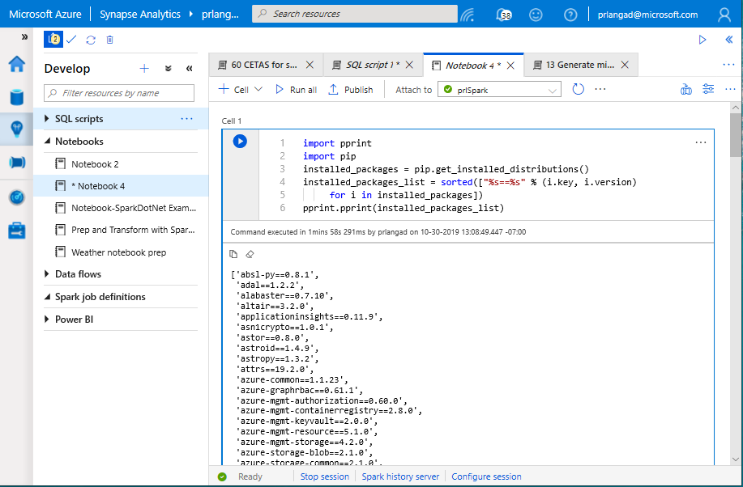
Library Management - Python
Get list of installed libraries with version information

Slide 42
Best practices

Slide 43
CCI vs Heap
Transformations using Heap tables are generally faster than CCI. This is because rows need to be assembled from column stores on read tables, and columnar compression is needed on targets.
The wider the table, and the more text fields it contains, the faster Heap is over CCI.
Use Heap tables at transformation layer, use CCI tables where appropriate at presentation layer

Slide 44
CCI Best Practice
MAX data types not supported
At least 60million rows * number of partitions
At least 100k rows per batch, up to 1million
Load using at least LARGERC or STATICRC60
Minimal UPDATE and DELETE (or REBUILD frequently)

Slide 45
Statistics
Do not rely on auto statistics at this time. Auto statistics are created, but never updated. This leads to poor performance as a table changes
Manually create statistics on columns used in JOIN, GROUP BY and ORDER BY clauses
Update statistics after every major update to a table
Failure to maintain current statistics WILL lead to bad performance

Slide 46
CTAS vs Insert / Update / Delete / Merge
Prefer CTAS when you update or delete more than 10% of rows
Prefer CTAS when you are updating or deleting a clustered Columnstore index, and do not have time for an offline rebuild

Slide 47
UPDATE FROM and DELETE FROM
Azure Synapse Analytics does not currently support (*) joins in UPDATE FROM and DELETE FROM queries.
Implement the join as a temporary / transient table, then UPDATE / DELETE from that table
(*) Coming soon

Slide 48
Simple is better than clever
Persist standard columns early, to avoid calculations and functions in WHERE clause
Unroll CTEs and JOIN sub-selects to transient / temporary tables to manage distribution
Simple queries are easier to tune and debug

Slide 49
Thank You slide
Thank you

